Slide 1
Cse 416
Software Design

Slide 2
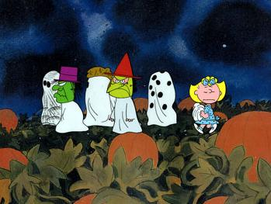
Did you enjoy Halloween?

Slide 3
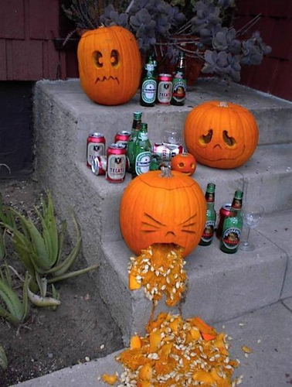
Did anyone make a Jack O'Lantern

Slide 4
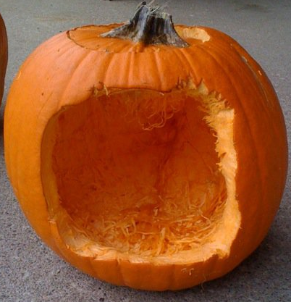
Without a plan, your Jack is doomed

Slide 5
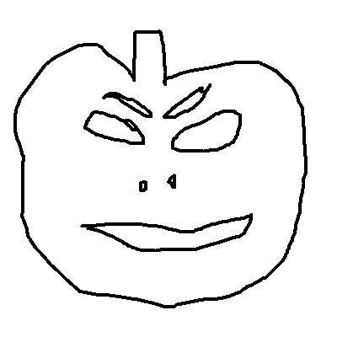


Design, prototype, then implement

Slide 6
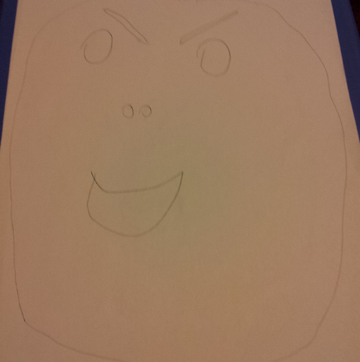
Design

Slide 7
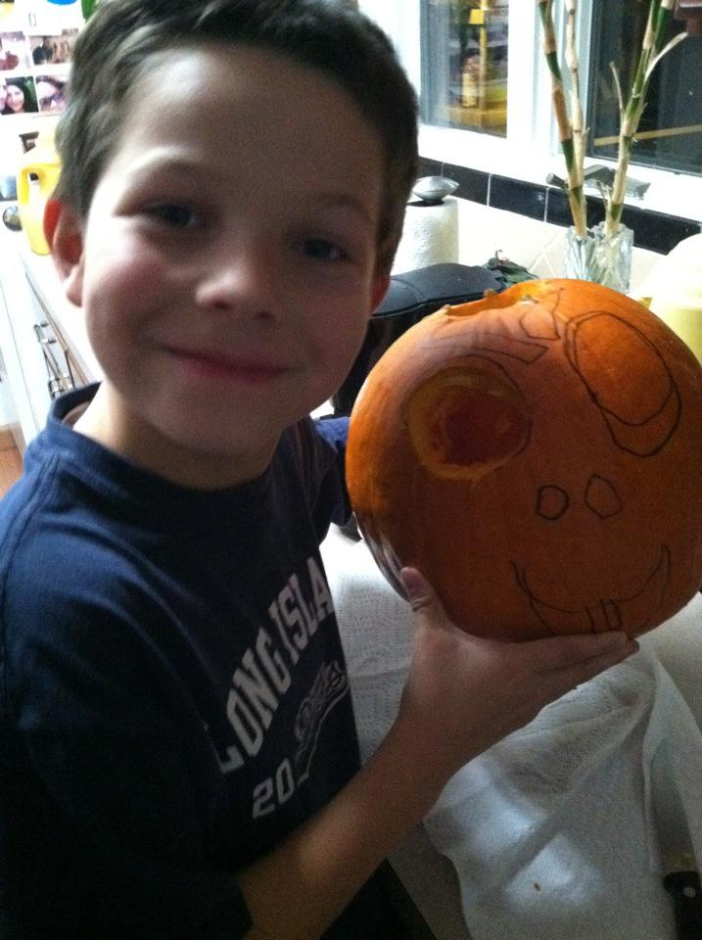
Prototype

Slide 8
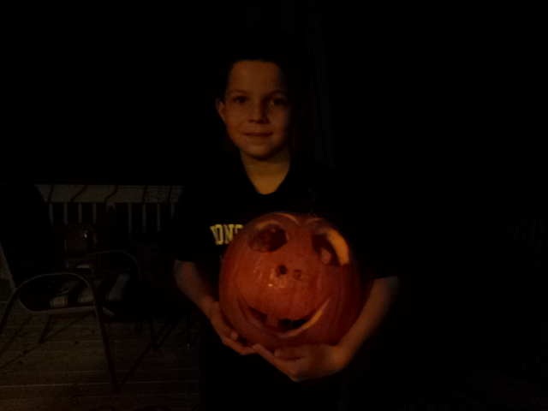
Implement

Slide 9

Enjoy

Slide 10

And of course smash

Slide 11
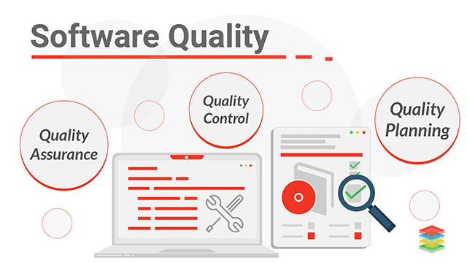
High Quality Software Properties
Correctness, Efficiency, Ease of use, Reliability/robustness, Reusability, Maintainability, Modifiability, Testability, Extensibility, Scalability
When should we consider these properties?
the requirements analysis & design stages
How about the implementation stages?
too late to make a big impact
Notes:
Image Reference: https://www.xenonstack.com/insights/what-is-software-quality

Slide 12
How can these properties be achieved?
By using well proven, established processes
preferably while taking advantage of good tools
Software Development Life Cycle
Requirements Analysis
Design & Document
Evaluate Design
Code
Test
Deploy
Profile
Debug

Slide 13
First we have to decide what to build
Requirements Analysis produces a Software Requirements Specification
Requirements Analysis also known as Requirements Engineering
Requirements Analysis
Design & Document
Evaluate Design
Code
Test
Deploy
Profile
Debug

Slide 14

So what’s an SRS?
Defines the problem to be solved
Why are we making this software?
What, exactly, are we going to make?
IEEE has a recommended format
830-1998
Explanation of problem
Detailed description of Use Cases
Mock-up diagrams of User Interface
Summary

Slide 15
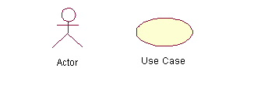
UML Use Case Diagram
Describes an interaction between a user and a system
Each Use Case Diagram describes a User Scenario:
all the active things a user will do (Use Cases) when interacting with the system in order to complete some task
To draw a Use Case Diagram:
List a sequence of steps a user might take in order to complete an action.
Each Use Case:
should start with a verb, which will be an action taken by the user
should name used UI controls and example data as needed

Slide 16
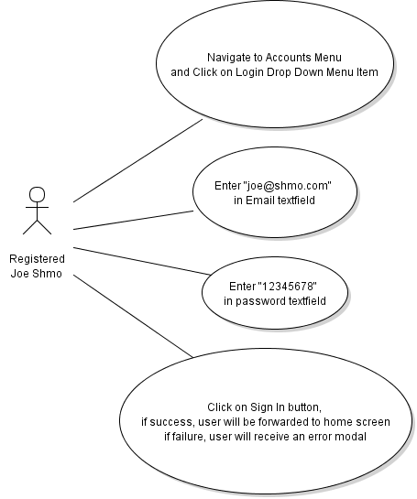
Use Case Diagram Example – Login to Account

Slide 17
Formal Use Case Diagrams
Use-Case Number: | SRS diagram number (typically 2.X format).
Use-Case Name: | This brief label should be unique and should adequately describe the interaction so that a developer reading your document may easily scan and find it by name and have good idea what it is.
Actors: | List all the actors who have site privileges that let them perform this interaction.
Preconditions: | What application conditions are necessary before this interaction can even take place?
Postconditions: | What is the net result of the interaction?
Story: | A numbered, step by step description of how the user will interact with the system in order to properly complete the use case. The story should include specific user interface components and interactions, like buttons and left-mouse clicks.
Scenario: | A scenario uses sample data to provide an instance of a story. All data entry and selection should be described here with data that might be used in your application for a user interaction.
Exceptions: | List all the things that could go wrong if either the user or some other external entity fails. For example, if a user fails to follow the proper procedures or if use of a remote technology fails. In addition to listing these potential problems describe how the application will handle these potential situations.
Priority: | List the importance of this use case for the proper functionality of the application.Essential means the application can not exist without it. Value Adding means it would significantly improve your application but the application could still work without it. Wish List means a use case that would be nice to have if time permits.
When available: | Specify the Implementation Build when your team plans for it to be completed
Frequency of use: | Specifies how this interaction is likely to take place. For example, once per site lifetime, once per account lifetime, once per session, many times per session, etc.
Open Issues: | List all potential development issues here, like things that may not yet have been determined or problems that may need to be resolved. For example, will the implementation of the use case need to make use of special software or apis?

Slide 18
Formal Use Case Diagrams
Use-Case Number: | 2.5
Use-Case Name: | Login
Actors: | Registered User
Preconditions: | The user has an account and has navigated to the site.
Postconditions: | The user is logged in and can use account services
Story: | Bring mouse to top-right corner of interface where the accounts menu is and click on the menu so that it opens a drop down Menu. Click on the Login Menu Item there. This will forward the user to the Login Screen. On that screen, enter the email and password for the user account into the appropriate Text Fields and click on the Sign In Button. This will log the user in and forward them home.
Scenario: | 1. Navigate to Accounts Menu and Click on Login Drop Down Menu Item 2. Enter "joe@shmo.com" in Email Text Field 3. Enter "12345678" in password Text Field 4. Click on Sign In Button, if success, user will be forwarded to home screen if failure, user will receive an error modal
Exceptions: | If the user enters the wrong email or password a dialog will open telling them their login failed.
Priority: | Essential
When available: | Build #1
Frequency of use: | Once per Session
Open Issues: | Look and feel of UI components to be determined by the UI designer

Slide 19
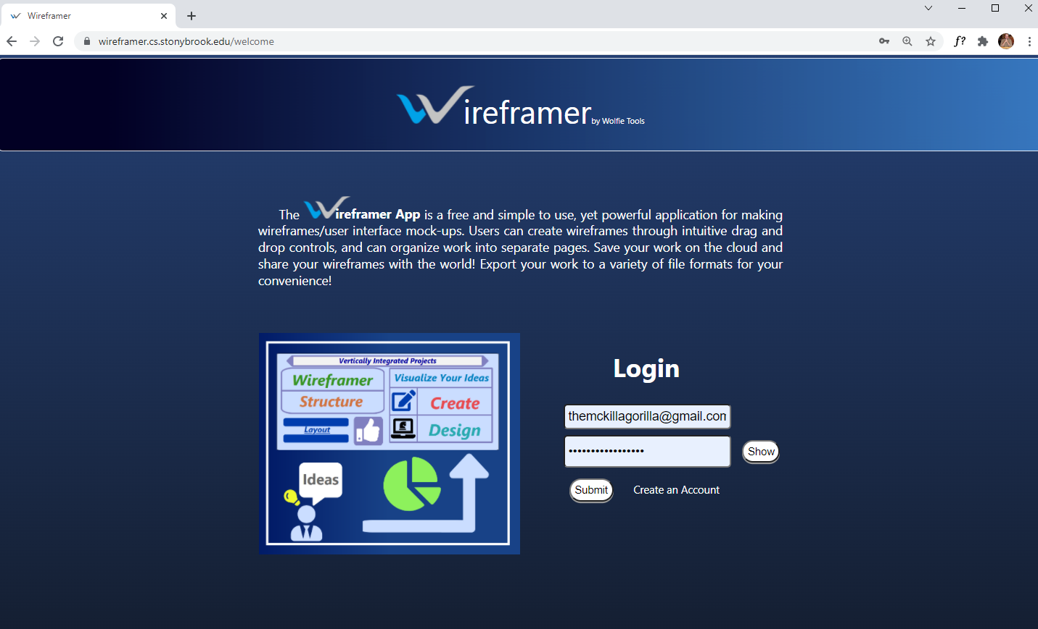
User Interface Mockup Diagrams

Slide 20
Next we design, i.e. decide how to build it
Many Software Design Diagram Formats
diagrams are good at summarizing complicated things efficiently
easier to edit than code
Software Development Life Cycle
Requirements Analysis
Design & Document
Evaluate Design
Code
Test
Deploy
Profile
Debug

Slide 21
Architects, Designers, and Programmers
Architect
big picture decisions (what modules are needed and how they should fit together)
affects everything done by everyone
experienced programmer and designer within a domain
Designer
creates structural and functional code designs for major modules
generates code specifications
experienced programmer
Programmer
knows how to implement code specifications

Slide 22
Beware of over-design
Why not design every last detail?
difficult
time consuming
expensive
might not be possible
burden of updating existing design documents
Bottom line: design important things that affect lots of code
architecture
major components
important decisions/difficult things
prevalent data flow

Slide 23
What should we design for the final project?
Requirements Design
Use Cases
User Interface Mock-Ups
Back-End API Software Design
Database Design (schemas)
Endpoints (routes)
Security layer (middleware)
Business logic (i.e. controllers)
Queries
Front-End Software Design
User Interface Components (composition, state management, handlers)
Data Store Management
HTTP Requests

Slide 24
UML Diagrams
UML - Unified Modeling Language
UML diagrams are one way to design object-oriented software systems
represent systems visually
provides a system architecture
hope to make coding more efficient and system more reliable
plan your code
Can software engineering be automated?
Visual programming
Patterns & frameworks
CASE tools

Slide 25
Before we get into design
It’s important to understand to know the tools
Important programming concepts and techniques
Rules of the language
Let’s Review
Memory Management
Apparent vs. Actual Types
IS-A relationships
HAS-A relationships
Aggregation vs. Composition

Slide 26
What is memory?
0xffffffff
Stack Segment
A giant array of bytes
How do we assign data to/get data from memory?
in Java we don't
the JVM does
using memory addresses
We use object ids/handles
Heap Segment
Text Segment
Global Segment
0x00000000

Slide 27
What goes in each memory segment?
0xffffffff
Stack Segment
Text Segment
stores program instructions
Global Segment
data that can be reserved at compile time
global data (like static data)
Heap Segment
Text Segment
Global Segment
0x00000000

Slide 28
What goes in each memory segment?
0xffffffff
Stack Segment
Stack Segment
temporary variables declared inside methods
method arguments
removed from memory when a method returns
Heap Segment
for dynamic data (whenever you use new)
data for constructed objects
persistent as long as an existing object variable references this region of memory
for Java, C#, Python, etc.
Heap Segment
Text Segment
Global Segment
0x00000000

Slide 29
Apparent versus Actual types
In some languages (like Java), objects have 2 types
Apparent type
the type an object variable was declared as
the compiler only cares about this type
affects what you can do with an object (enforced by compiler)
Actual type
the type an object variable was constructed as
the JVM only cares about this type
affects what happens at runtime (like which version of functions execute)
Important for method arguments and returned objects

Slide 30
IS-A relationships
private class Person {
protected String firstName;
protected String lastName;
…
public String toString()
{ return firstName + " " + lastName; }
}
private class Student extends Person {
private double GPA;
…
public String toString()
{ return "" + GPA; }
}

Slide 31
HAS-A relationships
private class Person {
private String firstName;
private String lastName;
…
public String toString()
{ return firstName + " " + lastName; }
}
private class Student {
private Person person;
private double GPA;
…
public String toString()
{ return "" + GPA; }
}

Slide 32
Aggregation vs. Composition
Distinguishes between two different HAS-A situations
For A HAS B
Aggregation: B can exist without A
ex: C also HAS B
Composition: B cannot exist unless part of A
These differences are all about understanding dependencies

Slide 33

What UML Diagrams will we use?
There are more than a dozen to choose from
Let’s use the most commonly used diagrams
UML Class Diagrams
static

Slide 34
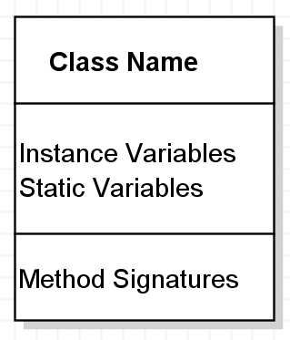
UML Class Diagrams
Used to design class structure:
instance variables, method signatures
class – class relationships
Relationship connector types:
IS-A
HAS-A (2 types)
Uses

Slide 35
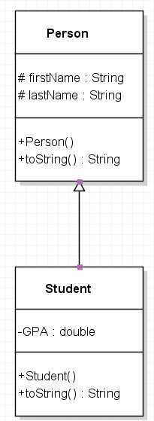
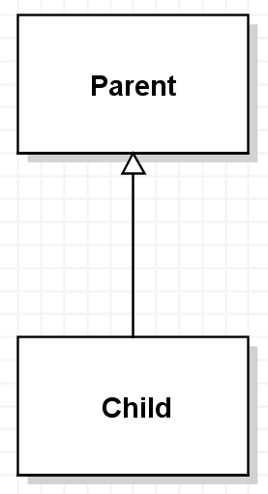
UML Class Diagrams – IS-A Relationships
Denotes inheritance
Child inherits from Parent

Slide 36
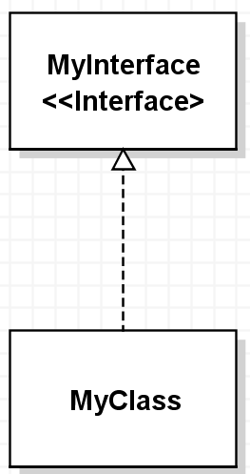
UML Class Diagrams – IS-A Relationships
Denotes implements
Child implements Interface
might be a concrete class
might be an abstract class

Slide 37
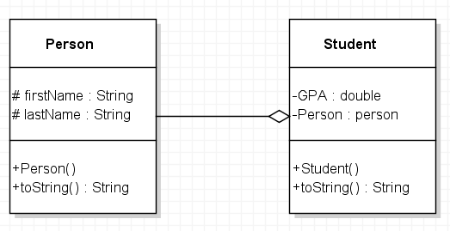
UML Class Diagrams – Aggregation HAS-A
Student HAS-A Person
Person can exist elsewhere

Slide 38
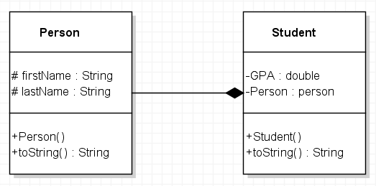
UML Class Diagrams – Composition HAS-A
What are the consequences of this?
Person must have some dependency on Student

Slide 39
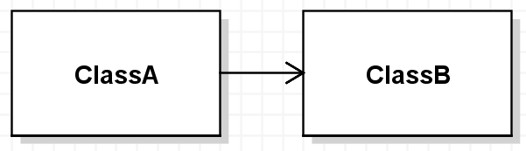
UML Class Diagrams – Uses Relationships
One class makes use of another
all other cases
local variable, method argument, etc.
Ex: ClassA uses ClassB

Slide 40
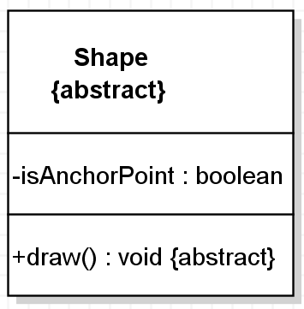
Some UML Class Diagram Notation
$ static
+ public
- private
# protected
<<I>> or <<interface>>
{abstract} or italicizization

Slide 41
Lots of other UML Formats
More than a dozen
We’ve seen class and use case
Another common dynamic format is UML Sequence diagrams
likely you’ll see these in CSE 416

